Slide 1


Final Presentation
ClostraBio ELC Team

Slide 2
Agenda
Objectives
Recap
Additional Research
Recommendations
Conclusion
Notes:
Additional Research: Vitamin A, Competitive Market Analysis and Small Intestine research
Recommendations: Small Intestine as target market and Product pricepoint

Slide 3

Objectives
Market opportunities
Treatment costs
Map competitive landscape
Small intestine market
Estimated product price

Slide 4
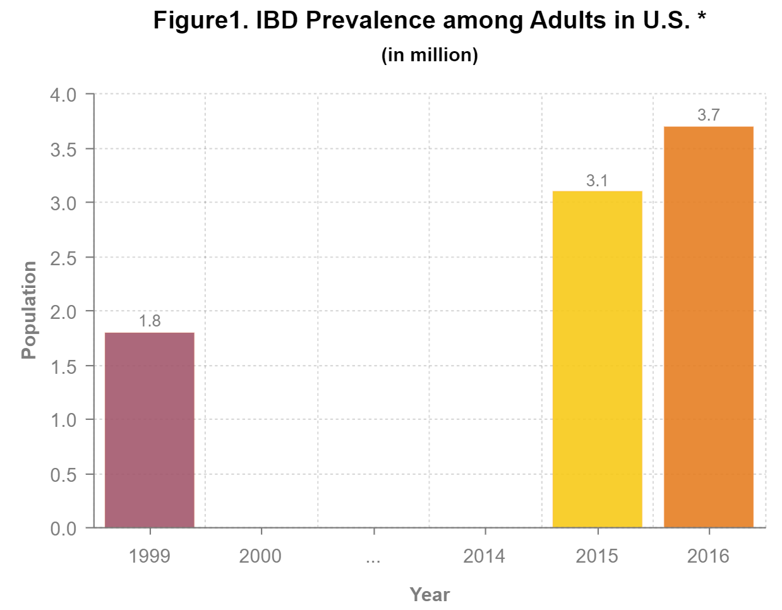
Mid-Semester Recap
Market Opportunity
Direct Competitors
Indirect Competitors
Small Intestinal Data
NHIS Study (2015)
Notes:
-Market Opportunity - In the previous presentation, we identified the prevalence of IBD in the United States, found a growing trend of patients suffering from IBD, and discussed the economic burden of IBD.
-Direct Competitors - For direct competitors, we identified the 3 main drug types (5-ASA, Immunomodulators, and corticosteroids) and broke down the costs associated with these drugs.
-Indirect Competitors - For indirect competitors, we discussed the wound healing of intestinal cells, alternative therapies for IBD, and nutritional deficiency.
- Small Intestinal Data - We then discussed the different types of Crohn's disease, as well as the medications associated with that disease specifically, and we concluded with a discussion of the different types of surgerys for Crohn’s disease.

Slide 5
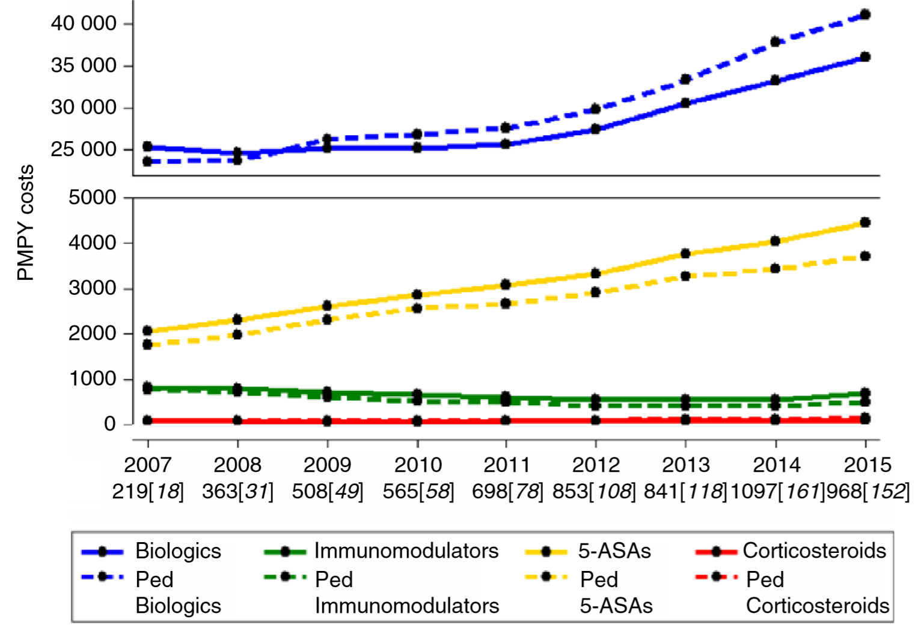
Mid-Semester Recap
Market Opportunity
Direct Competitors
Indirect Competitors
Small Intestinal Data
Notes:
-Market Opportunity - In the previous presentation, we identified the prevalence of IBD in the United States, found a growing trend of patients suffering from IBD, and discussed the economic burden of IBD.
-Direct Competitors - For direct competitors, we identified the 3 main drug types (5-ASA, Immunomodulators, and corticosteroids) and broke down the costs associated with these drugs.
-Indirect Competitors - For indirect competitors, we discussed the wound healing of intestinal cells, alternative therapies for IBD, and nutritional deficiency.
- Small Intestinal Data - We then discussed the different types of Crohn's disease, as well as the medications associated with that disease specifically, and we concluded with a discussion of the different types of surgerys for Crohn’s disease.

Slide 6
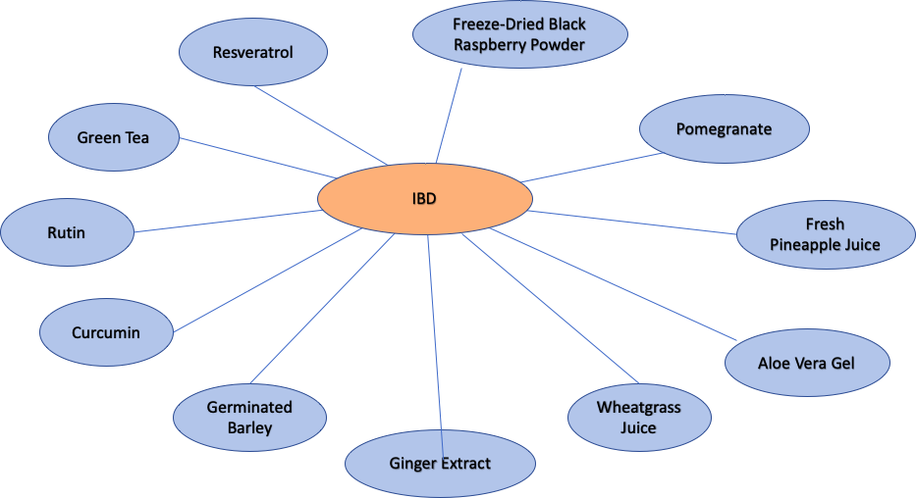
Mid-Semester Recap
Market Opportunity
Direct Competitors
Indirect Competitors
Small Intestinal Data
Notes:
-Market Opportunity - In the previous presentation, we identified the prevalence of IBD in the United States, found a growing trend of patients suffering from IBD, and discussed the economic burden of IBD.
-Direct Competitors - For direct competitors, we identified the 3 main drug types (5-ASA, Immunomodulators, and corticosteroids) and broke down the costs associated with these drugs.
-Indirect Competitors - For indirect competitors, we discussed the wound healing of intestinal cells, alternative therapies for IBD, and nutritional deficiency.
- Small Intestinal Data - We then discussed the different types of Crohn's disease, as well as the medications associated with that disease specifically, and we concluded with a discussion of the different types of surgerys for Crohn’s disease.

Slide 7
Mid-Semester Recap
Small Intestine Crohn’s Disease types
Ileocolitis
Ileitis
Gastroduodenal
Jejunoileitis
Market Opportunity
Direct Competitors
Indirect Competitors
Small Intestinal Data
Notes:
-Market Opportunity - In the previous presentation, we identified the prevalence of IBD in the United States, found a growing trend of patients suffering from IBD, and discussed the economic burden of IBD.
-Direct Competitors - For direct competitors, we identified the 3 main drug types (5-ASA, Immunomodulators, and corticosteroids) and broke down the costs associated with these drugs.
-Indirect Competitors - For indirect competitors, we discussed the wound healing of intestinal cells, alternative therapies for IBD, and nutritional deficiency.
- Small Intestinal Data - We then discussed the different types of Crohn's disease, as well as the medications associated with that disease specifically, and we concluded with a discussion of the different types of surgerys for Crohn’s disease.

Slide 8
IBD Treatment alternatives
Vitamins and Minerals
Vitamin supplements
Calcium
Iron

Slide 9

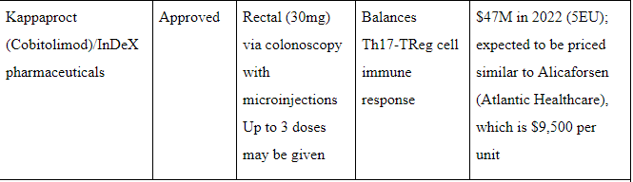
Competitive Market Analysis
Drugs in Pipeline : UC

Slide 10
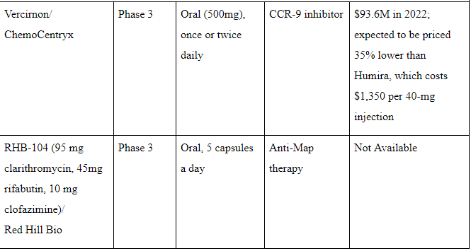
Competitive Market Analysis
Drugs in Pipeline : CD

Slide 11
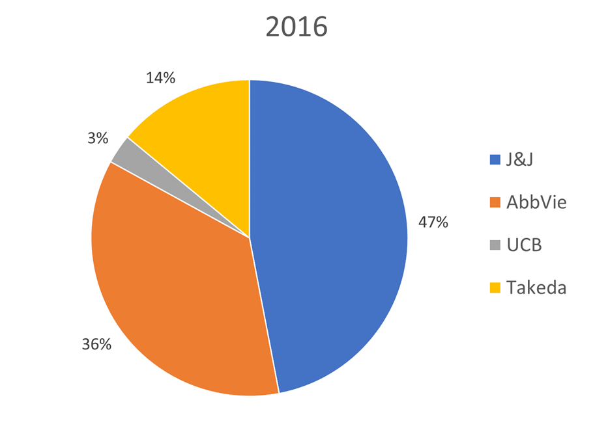
Competitive Market Analysis Biologics Leaders

Slide 12
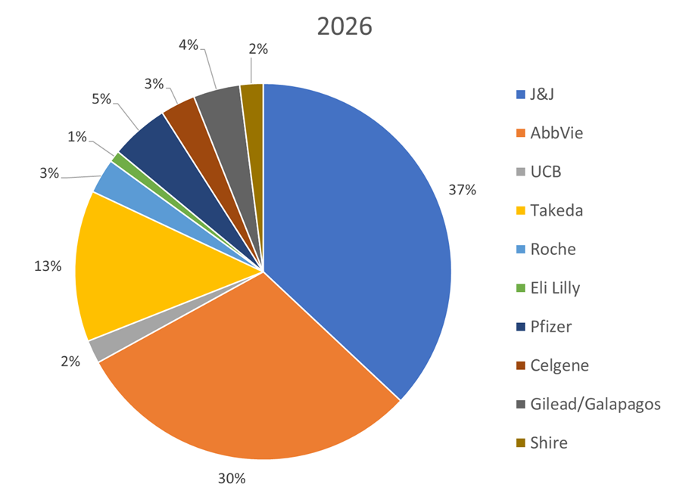
Competitive Market Analysis Biologics Leaders

Slide 13
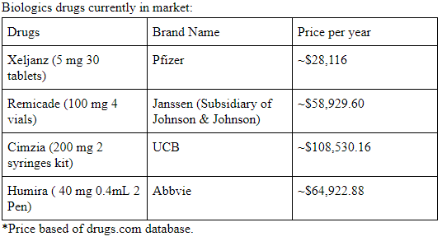
Competitive Market Analysis
Biologics

Slide 14
Treatment Risks
Medications | Side effects
Corticosteroid | Weight gain Osteoporosis Cushing syndrome Glucose intolerance Glaucoma
Immunomodulators | Spontaneous infection Myelotoxicity Pneumonitis Organ toxicities
Biologics | Reactivation of tuberculosis Increased risk of sepsis & opportunistic infections Reactivation of hepatitis B
Notes:
This section will be shortened

Slide 15
Biologics for CD
Remission of active CD and preventing relapse
Inﬂiximab -
Maintenance of remission
Recurrence of CD
patients treated with inﬂiximab - 27.3%
patients treated with placebo - 84.6%
Eliminate future surgeries

Slide 16
Transmural Healing
Better long‐term clinical outcomes
Category | Transmural Healing | Mucosal Healing | No Healing
Steroid free clinical remission | 95.6% | 75% | 41%
Rate of hospitalization | 8.8% | 28.3% | 66.6%
Need for surgery | 0% | 10% | 35.5%

Slide 17
Recommendations
Small Intestine Market
Potential target market: small intestine
Prevalence
VS biologics treatments
Avg surgery costs:
Few primary studies
 | Out of network | In network
Small intestine resection | $20,658 | $8,892
Strictureplasty | $8,268 | $3,449

Slide 18
Recommendations
Small Intestine Market
Prevalence by severity (in thousands)
IBD 3.7 M | CD (~46.24%) 1,700K | Remission (~60%) | 1,020
 |  | Mild (~20%) | 340
 |  | Moderate – severe (~20%) | 340
 | UC (~53.76%) 2,000K | Remission (~48%) | 960
 |  | Mild (~30%) | 600
 |  | Moderate (~20%) | 400
 |  | Severe (~2%) | 40

Slide 19
Recommendations
Small Intestine Market
Prevalence by CD type (in thousands)
CD 1,700K | Ileocolitis (~45%) | 765
 | Ileitis (~26%) | 442
 | Gastroduodenal (~5%) | 85
 | Jejunoileitis (~4%) | 68
 | Crohn’s colitis (~20%) | 340

Slide 20
Recommendations
Small Intestine Market
Potential target market: small intestine
Prevalence
VS biologics treatments
Avg surgery costs:
Few primary studies
 | Out of network | In network
Small intestine resection | $20,658 | $8,892
Strictureplasty | $8,268 | $3,449

Slide 21
Recommendations
Product Price Point
Factors to consider
Effectiveness of biologics
Combination Therapy
Price Recommendation - $2,500

Slide 22
Conclusion
Objectives
Research
Market Opportunity
IBD Prevalence by Severity
Pipeline Market
Direct and Indirect competitors
Current Treatment Cost
Alternative Treatment
Biologics
Small Intestine market
Recommendations

Slide 23



